Slide 1
DATATHON TEAM 9
Lewis Parnham, Onyi Eke &
Marieme Diop
Notes:
Lewis, Onyi, with a thanks to Marieme OoO – Worked on Vis also

Slide 2
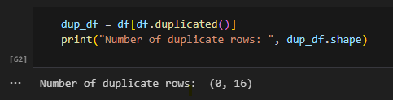
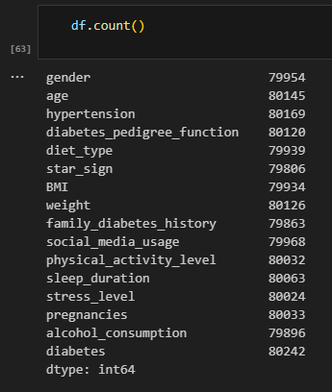
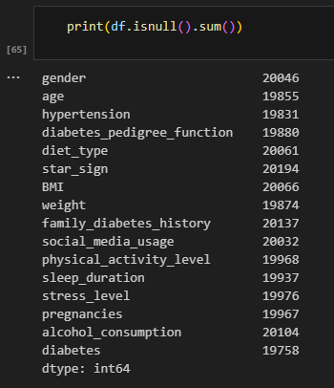
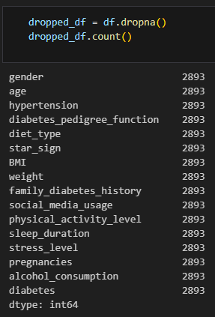
Initial Analysis
Understanding the Data:
Notes:
Exploring data
Understanding shapes
Checking duplicates
Dropping nulls – very small subset of data

Slide 3
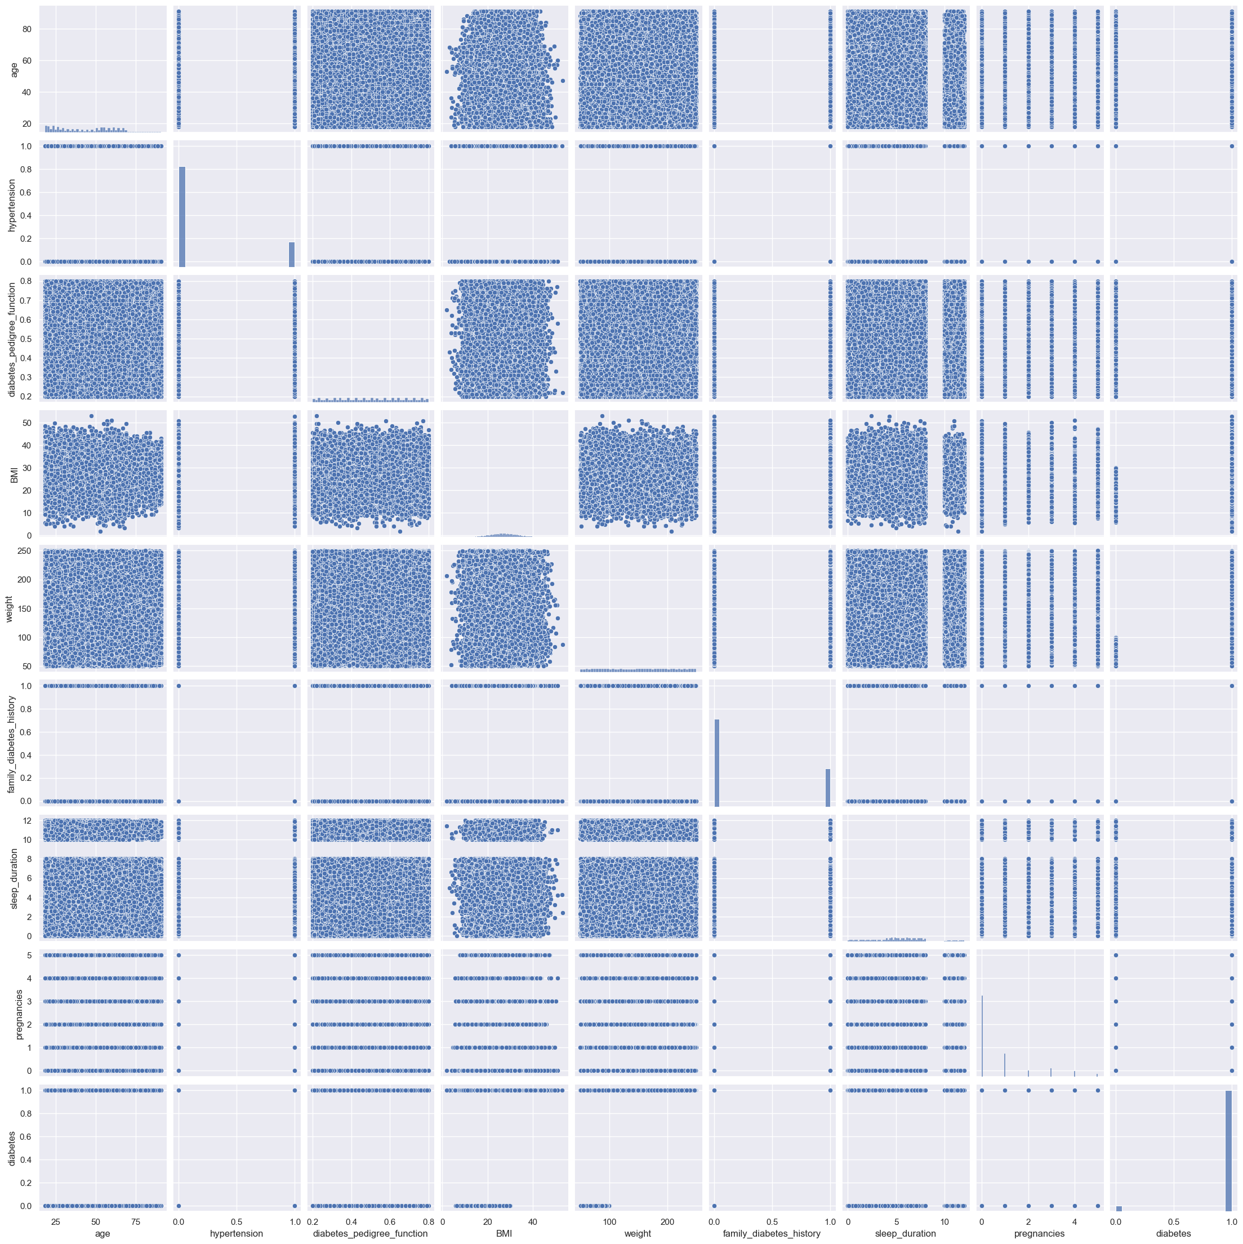
Initial Analysis
Pairplot:
Notes:
Initial visual analysis
Determine any correlations

Slide 4
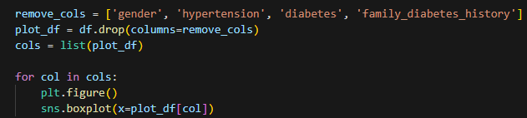
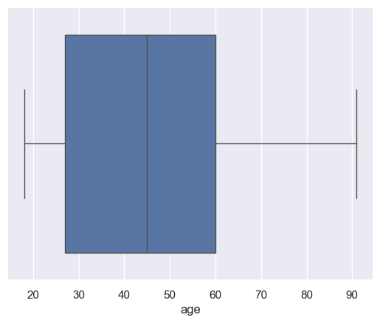
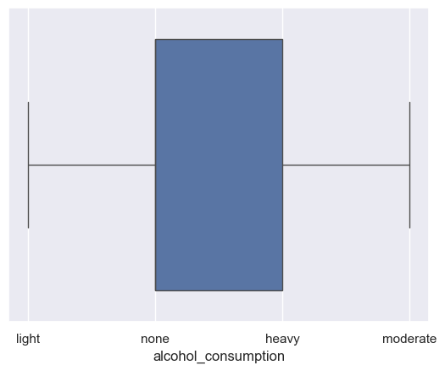
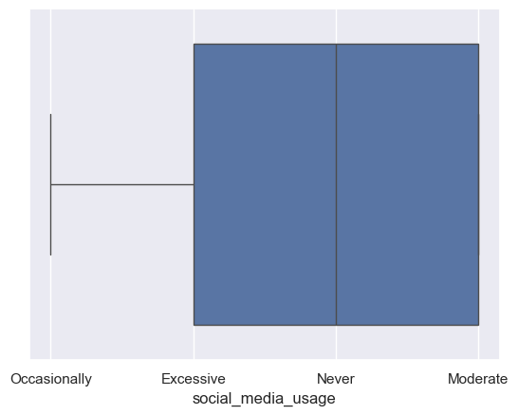
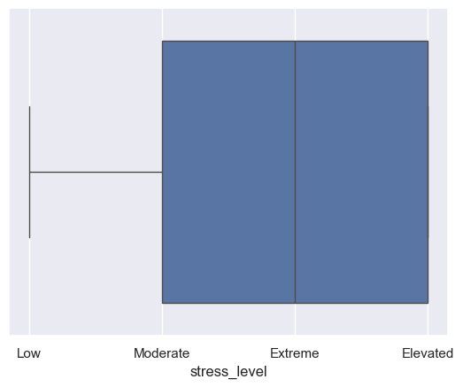
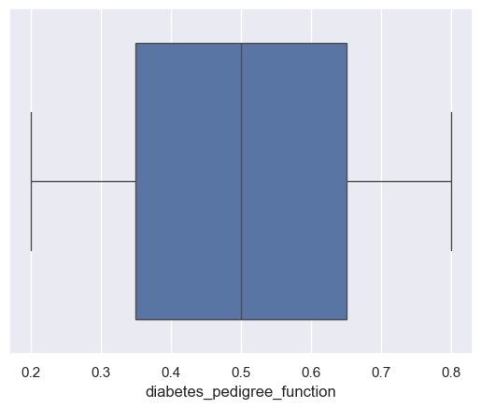
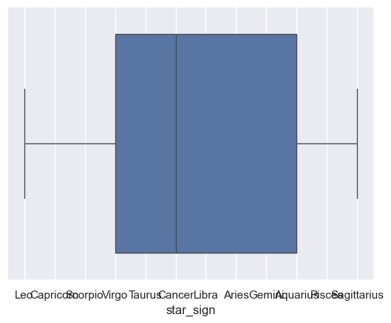
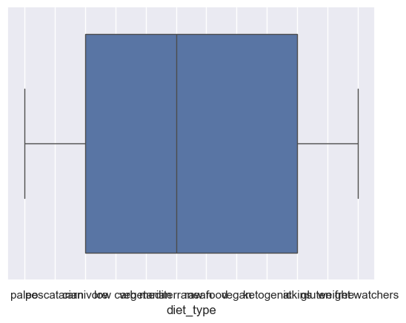
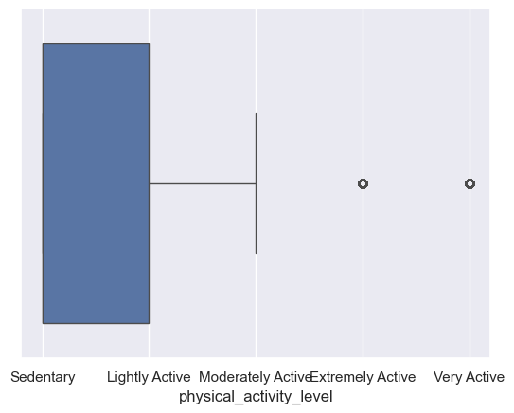
Initial Analysis
Boxplots:
Notes:
Boxplots
Understand data spread
Iterate over columns and produce a boxplot

Slide 5
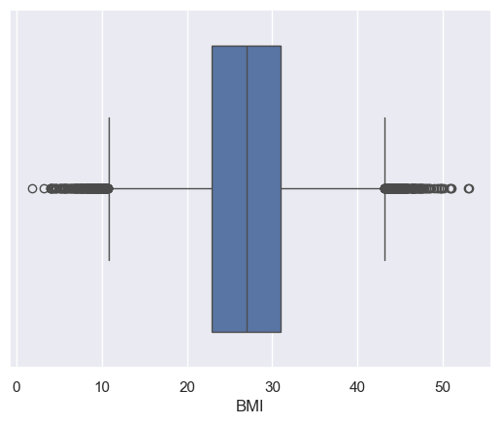
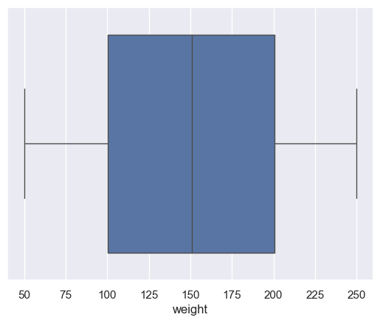
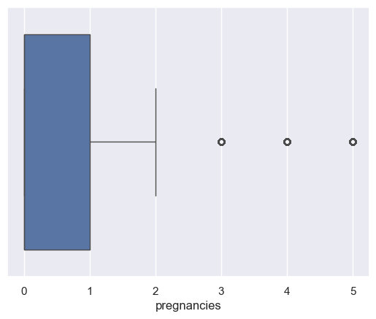
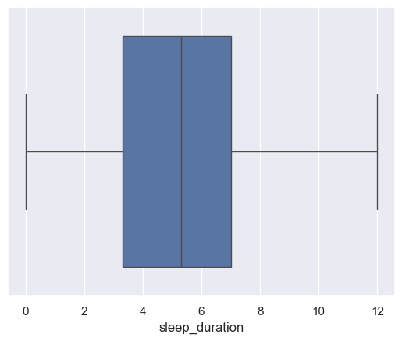
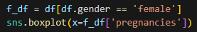
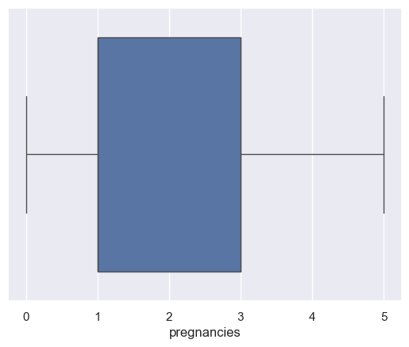
Initial Analysis
Boxplots – Outliers/Oddities:
Notes:
Obvious outliers for BMI
Dissect box plots
Sleep: Min 0, lowest quartile 3.3, mean, 5.3, third quartile only 7, max 12
Pregnancies showing outliers – no outliers when considering only females

Slide 6
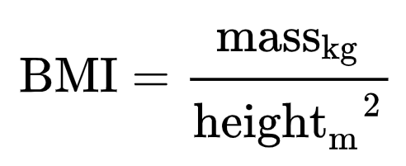
BMI/Weight Oddities
Calculating Height:
 | gender | age | hypertension | diabetes_pedigree_function | BMI | weight | family_diabetes_history | social_media_usage | physical_activity_level | sleep_duration | stress_level | pregnancies | alcohol_consumption | diabetes
count | 79954 | 80145 | 80169 | 80120 | 79934 | 80126 | 79863 | 79968 | 80032 | 80063 | 80024 | 80033 | 79896 | 80242
mean | 0.449396 | 45.10731 | 0.202248 | 0.500877 | 26.978545 | 150.5266 | 0.302167 | 1.498599 | 0.564312 | 5.295149 | 2.501662 | 0.758212 | 1.565473 | 0.954936
std | 0.497436 | 18.55043 | 0.401678 | 0.173783 | 6.005039 | 57.73154 | 0.4592 | 1.117626 | 0.7824 | 2.842133 | 1.117961 | 1.281326 | 1.274107 | 0.207445
min | 0 | 18 | 0 | 0.2 | 1.8 | 50 | 0 | 0 | 0 | 0 | 1 | 0 | 0 | 0
25% | 0 | 27 | 0 | 0.35 | 22.9 | 100.3 | 0 | 0 | 0 | 3.3 | 2 | 0 | 0 | 1
50% | 0 | 45 | 0 | 0.5 | 27 | 150.9 | 0 | 2 | 0 | 5.3 | 3 | 0 | 1 | 1
75% | 1 | 60 | 0 | 0.65 | 31 | 200.4 | 1 | 2 | 1 | 7 | 4 | 1 | 3 | 1
max | 1 | 91 | 1 | 0.8 | 53.1 | 250 | 1 | 3 | 4 | 12 | 4 | 5 | 3 | 1
 | gender | age | hypertension | diabetes_pedigree_function | BMI | weight | family_diabetes_history | social_media_usage | physical_activity_level | sleep_duration | stress_level | pregnancies | alcohol_consumption | diabetes | height
count | 79954 | 80145 | 80169 | 80120 | 79934 | 80126 | 79863 | 79968 | 80032 | 80063 | 80024 | 80033 | 79896 | 80242 | 64102 | count
mean | 0.449396 | 45.10731 | 0.202248 | 0.500877 | 26.978545 | 150.5266 | 0.302167 | 1.498599 | 0.564312 | 5.295149 | 2.501662 | 0.758212 | 1.565473 | 0.954936 | 2.364425 | mean
std | 0.497436 | 18.55043 | 0.401678 | 0.173783 | 6.005039 | 57.73154 | 0.4592 | 1.117626 | 0.7824 | 2.842133 | 1.117961 | 1.281326 | 1.274107 | 0.207445 | 0.573315 | std
min | 0 | 18 | 0 | 0.2 | 1.8 | 50 | 0 | 0 | 0 | 0 | 1 | 0 | 0 | 0 | 1.06409 | min
25% | 0 | 27 | 0 | 0.35 | 22.9 | 100.3 | 0 | 0 | 0 | 3.3 | 2 | 0 | 0 | 1 | 1.929306 | 25%
50% | 0 | 45 | 0 | 0.5 | 27 | 150.9 | 0 | 2 | 0 | 5.3 | 3 | 0 | 1 | 1 | 2.365016 | 50%
75% | 1 | 60 | 0 | 0.65 | 31 | 200.4 | 1 | 2 | 1 | 7 | 4 | 1 | 3 | 1 | 2.750973 | 75%
max | 1 | 91 | 1 | 0.8 | 53.1 | 250 | 1 | 3 | 4 | 12 | 4 | 5 | 3 | 1 | 10.72122 | max
Notes:
BMI: Min 1.8, lowest quartile 22.9, mean 27, third quartile 31, max 53.1
Weight: Min 50, lowest quartile 100, mean 151, third quartile 200, max 250
BMI is a function of weight and height – we can reverse to find height
Height: Min 106cm, lowest quartile 192cm, mean 236cm, third quartile 275cm, max 1072cm
Put into perspective the average height of a basketball player in the 2022-2023 NBA season is 198.6cm or 6’6 is and our average is 7’9 (236cm)
Very tall, very sleep deprived population

Slide 7
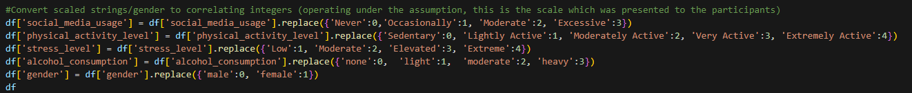
Removing Strings
 | gender | age | hypertension | diabetes_pedigree_function | diet_type | star_sign | BMI | weight | family_diabetes_history | social_media_usage | physical_activity_level | sleep_duration | stress_level | pregnancies | alcohol_consumption | diabetes
0 | 1 | NaN | NaN | 0.37 | paleo | NaN | NaN | 197.7 | NaN | 1 | 0 | 1.5 | 1 | NaN | 1 | 1
1 | 0 | 59 | 0 | 0.73 | NaN | Leo | 17.1 | 156.5 | 0 | 1 | 1 | 5.4 | 2 | 0 | 0 | 1
2 | 1 | 31 | NaN | NaN | NaN | NaN | 22.5 | 137.8 | NaN | 1 | 1 | 7.6 | 1 | 0 | 1 | 1
3 | 1 | 81 | 1 | 0.37 | pescatarian | NaN | NaN | 108.2 | 0 | NaN | 0 | 7.7 | 1 | 1 | 3 | NaN
4 | NaN | 64 | 0 | 0.55 | carnivore | NaN | NaN | 179.7 | NaN | 1 | 0 | 7.8 | NaN | 0 | 3 | 1
... | ... | ... | ... | ... | ... | ... | ... | ... | ... | ... | ... | ... | ... | ... | ... | ...
99995 | 0 | 24 | NaN | 0.29 | vegetarian | Libra | 18.9 | 56 | 0 | 0 | 0 | 2.6 | 3 | 0 | 1 | 1
99996 | 0 | 53 | 1 | 0.64 | weight watchers | NaN | 28.4 | 140.8 | NaN | 3 | 1 | 7.5 | 2 | 0 | NaN | 1
99997 | 0 | 61 | 0 | 0.34 | NaN | Taurus | NaN | NaN | NaN | 3 | 1 | 2.8 | 2 | 0 | 3 | 1
99998 | 0 | NaN | 0 | 0.71 | mediterranean | Leo | 28.8 | 123.6 | 0 | 3 | 0 | 0.4 | 2 | 0 | 0 | 1
99999 | 0 | 63 | NaN | 0.46 | ketogenic | Aquarius | NaN | NaN | NaN | 1 | 0 | 7.5 | 1 | 0 | 0 | 1
Notes:
Strings on a scale – could have been represented by a slider or radio buttons in a survey
Allows us to populate nulls with mean values.

Slide 8
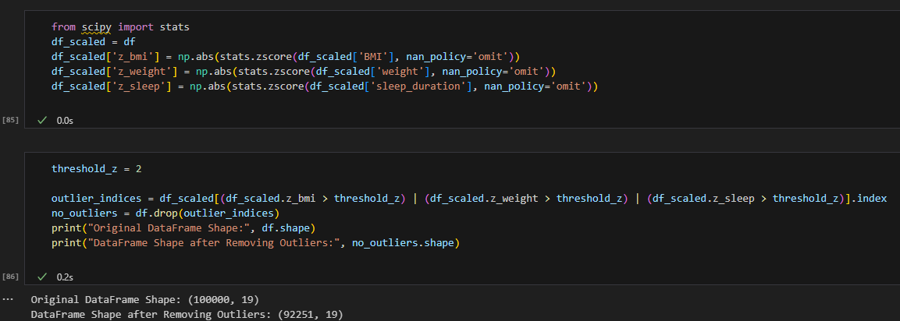
Removing Outliers
Z-Score:
Notes:
Tried omitting nulls first due to the massive drop in data – second time, replaced nulls with avg
Removing around 7.7k records with threshold of 2

Slide 9
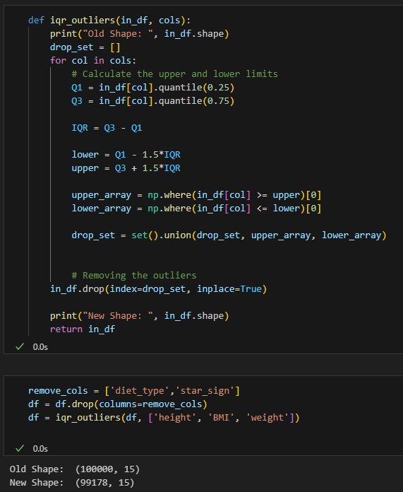
Removing Outliers
IQR (Interquartile Range):
Notes:
Experimented with z scores – settled for IQR – most common – maps to boxplots
To improve reusability, the created function takes a DataFrame and a list of columns to remove outliers from.
Outliers are considered if they are below our 1st quartile (lowest 25%) or greater than our 3rd quartile (highest 75%)
This results in the removal of 822 (when finding the outliers on ['height', 'BMI', 'weight']).
Prior to removing outliers, we have removed both the diet_type and star_sign columns as they are categorical data which could not be represented on a scale like the other data.

Slide 10
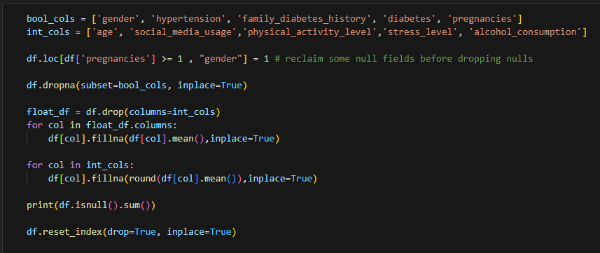
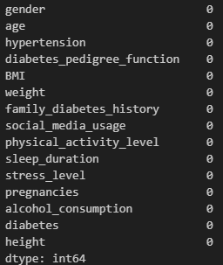
Removing Nulls
Notes:
In order to regain some values which will be potentially lost, we operated under the assumption gender is sex as there is only a male or female recorded and also no records denoted as male had pregnancies recorded against them so we can assume any people who recorded having a pregnancy is a female (allowing us to save over 5815 records which would have been removed)
Firstly, the boolean columns have their null values removed as we cannot populate them with averages. (['gender', 'hypertension', 'family_diabetes_history', 'diabetes', 'pregnancies']).
Secondly, our float columns have their nulls populated by the averages in their columns
Thirdly, we do the averaging on the int columns and then round the values so they can go to the nearest integers

Slide 11
Removing Nulls
Resulting dataset:
 | gender | age | hypertension | diabetes_pedigree_function | BMI | weight | family_diabetes_history | social_media_usage | physical_activity_level | sleep_duration | stress_level | pregnancies | alcohol_consumption | diabetes | height
count | 35550 | 35550 | 35550 | 35550 | 35550 | 35550 | 35550 | 35550 | 35550 | 35550 | 35550 | 35550 | 35550 | 35550 | 35550
mean | 0.495359 | 44.94242 | 0.200056 | 0.500019 | 27.04499 | 150.1721 | 0.303404 | 1.600422 | 0.65699 | 5.316513 | 2.603938 | 0.867651 | 1.656962 | 0.955077 | 2.351747
std | 0.499985 | 16.654 | 0.400048 | 0.156231 | 5.171155 | 51.54905 | 0.459735 | 1.016766 | 0.723289 | 2.534523 | 1.017878 | 1.335484 | 1.153299 | 0.207137 | 0.437573
min | 0 | 18 | 0 | 0.2 | 10.8 | 50 | 0 | 0 | 0 | 0 | 1 | 0 | 0 | 0 | 1.115618
25% | 0 | 31 | 0 | 0.38 | 24.1 | 112.9 | 0 | 1 | 0 | 4.1 | 2 | 0 | 1 | 1 | 2.187972
50% | 0 | 45 | 0 | 0.500019 | 27.04499 | 150.1721 | 0 | 2 | 1 | 5.316513 | 3 | 0 | 2 | 1 | 2.351747
75% | 1 | 57 | 0 | 0.61 | 29.9 | 187.3 | 1 | 2 | 1 | 6.6 | 3 | 1 | 3 | 1 | 2.523267
max | 1 | 91 | 1 | 0.8 | 43.1 | 250 | 1 | 3 | 4 | 12 | 4 | 5 | 3 | 1 | 3.979815
Notes:
This leaves us with only 35% of our original dataset which is workable due to the assumptions and decisions we have made in the above steps.

Slide 12
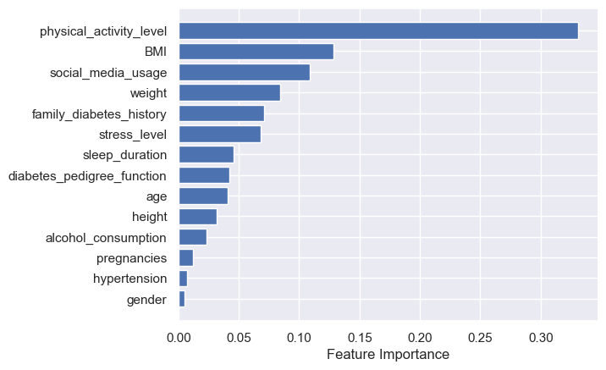
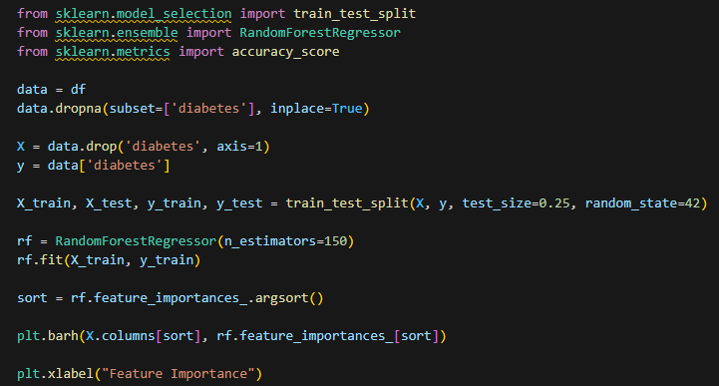
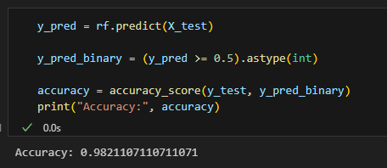
Experimental Modelling
Random Forest Regression Model:
Notes:
Regression model to look at getting feature importance
Worth noting in our final population:
most of the data was diabetic so there is fewer instances of none diabetic people
33.6k diabetics, only 1.6k not
Real world, would likely expect pedigree function, family diabetes history to play a bigger part with physical activity being important but lower in ranking
That wraps up the EDA/Data Science exploration of the data, I will hand over to Onyi to talk over the Data Visualisation aspect

Slide 13
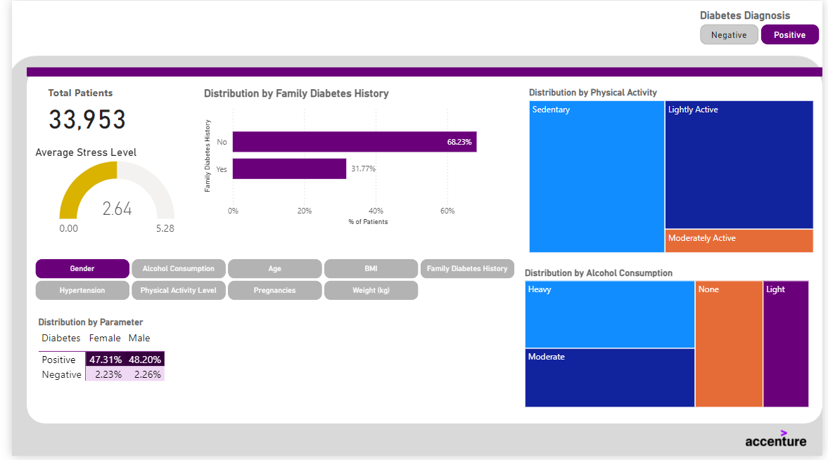
Data Report in Power BI
Overview:
We have created a streamlined easy-to read one page report highlighting the key factors associated with Diabetes.
Cleansed dataset comprises of ~34K Patients in the dataset are diagnosed with diabetes.
Associated Factors:
Physical Activities
Alcohol Consumption
Stress level
Gender
BMI

Slide 14
Data Report in Power BI
91% of diabetic patients live sedentary (47%) or lightly active (44%) lifestyles
Patients with very active physical levels are 26x more likely to have a negative diagnosis
PHYSICAL ACTIVITY
Heavy drinkers are 1.05x more likely to be diabetic
On the other hand, with no alcohol consumption, patients increase their chances of a negative diagnosis by 1.62x
ALCOHOL CONSUMPTION
Patients with High stress levels are more 1.06x more likely to be diagnosed with the illness
With low stress levels, they are 2x more likely to have a negative diagnosis
STRESS LEVEL
No significant correlation with BMI, likely as it is an outdated and poorly metric of measuring good health.
Diabetes diagnosis is evenly spread across genders (47.31% F, 48.20 M) even when there is a family history of diabetes (50.10 F, 49.90 M)
GENDER, BMI

Slide 15
Questions

